Slide 1
Liver Disease Prediction
Melvin Joshua

Slide 2
Project Abstract
This project focuses on predicting liver disease using a dataset of 1700 records. Through exploratory data analysis (EDA), key risk factors such as BMI, alcohol consumption, and liver function tests were identified. Various machine learning models, including Logistic Regression, Decision Tree, Random Forest, Support Vector Classifier, and Naive Bayes, were trained and evaluated using ROC curves. Model calibration was performed on the Decision Tree, and hyperparameters were fine-tuned for both Decision Tree and Random Forest to address overfitting. Among the models tested, Random Forest achieved the highest accuracy, offering valuable insights for early detection and potential prevention of liver disease. The tool used for modelling is the programming language, Python.

Slide 3
Problem Statement
In Healthcare, diagnosing a patient is the most important step because it provides a clear understanding of the patient’s medical condition.
This helps in the development of an appropriate treatment plan, finding the right treatment to increase the chances of successful recovery or improvement in health.
Misdiagnosis can lead to causing psychological stress and administering the wrong treatment may lead to severe consequences.

Slide 4
Objectives
Find the significant factors in predicting the Liver Disease.
Find the best model for diagnosing the patients correctly.

Slide 5
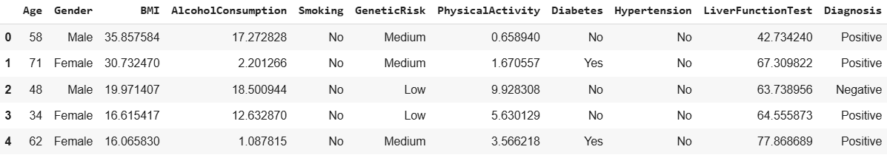
Data DescriptIon
This dataset has 1700 rows and 11 columns.
There is neither a missing record nor a duplicated record.
55% of patients are diagnosed as positive, and 45% as negative.

Slide 6
Attribute Information
Attribute | Range/Categories | Description
Age | 20 to 80 years | Age of the patient.
Gender | Male, Female | Gender of the patient.
BMI | 15 to 40 | Body Mass Index.
Alcohol Consumption | 0 to 20 units/week | Weekly alcohol intake.
Smoking | Yes, No | Smoking habit.
Genetic Risk | Low, Medium, High | Genetic predisposition to liver disease.
Physical Activity | 0 to 10 hours/week | Weekly physical activity.
Diabetes | Yes, No | Presence of diabetes.
Hypertension | Yes, No | Presence of high blood pressure.
Liver Function Test | 20 to 100 | Liver health score.
Diagnosis | Positive, Negative | Presence of liver disease.

Slide 7
Classification Models USED
Logistic Regression: Simple, interpretable, effective for binary classification, baseline model.
Decision Tree: Easy to interpret, handles non-linear relationships, provides feature importance.
Random Forest: Combines multiple decision trees to reduce variance and improve predictive performance.
Support Vector Classifier: Effective for high-dimensional data, handles complex decision boundaries.
Naïve Bayes Classifier: Fast, efficient with high-dimensional data, works well with smaller datasets.

Slide 8
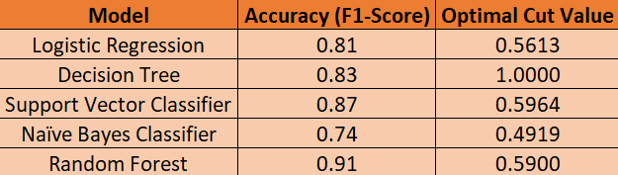
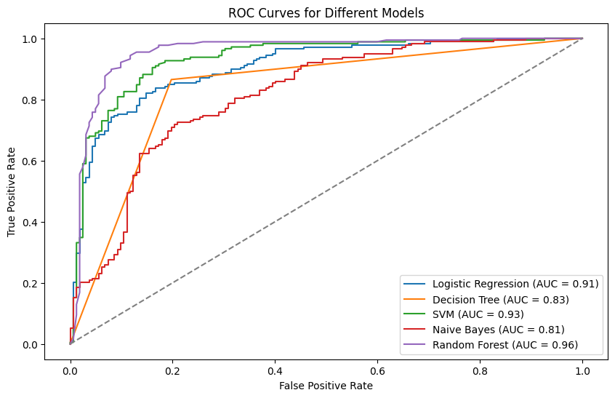
Model Evaluation
The Random Forest model demonstrated the highest accuracy and AUC score among the evaluated models. Therefore, it is considered the most reliable model for classification of Liver Disease.
However, the Optimal Cut Value for Decision Tree turned out to be 1, which is suspicious because it means the model diagnoses all the patients as negative in having Liver Disease, which is a huge risk for misclassification in the medical field. This issue should be fixed immediately to avoid severe consequences of getting False Negatives.

Slide 9
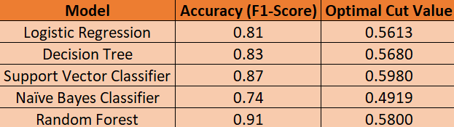
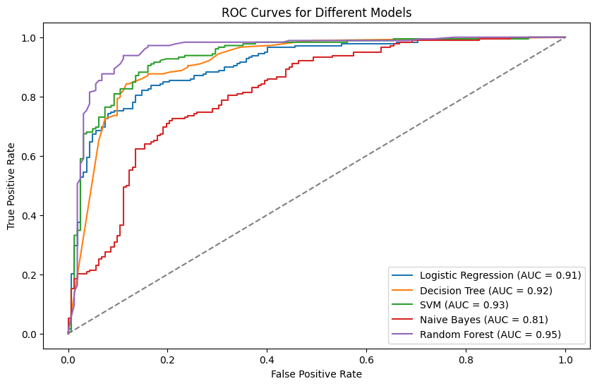
Model Calibration
The Decision Tree model has been calibrated with the help of this classifier:
CalibratedClassifierCV(DecisionTreeClassifier(), method='sigmoid')

Slide 10
Hyperparameter Tuning
Decision Tree seems to be overfitting and Random Forest is on the verge of overfitting.
The following hyperparameters of the models are tuned to fix this issue: 1. Decision Tree: Limiting max_depths and splits. 2. Random Forest: Limiting max_depths, splits and adding number of trees.
None of the models now overfit.

Slide 11
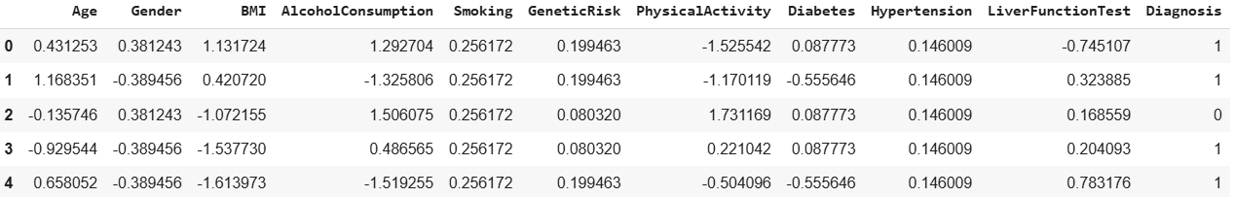
Logistic Regression with Weight of Evidence
After replacing the categories with their corresponding WoE values and scaling the numeric features, we get the following dataset for modelling:

Slide 12
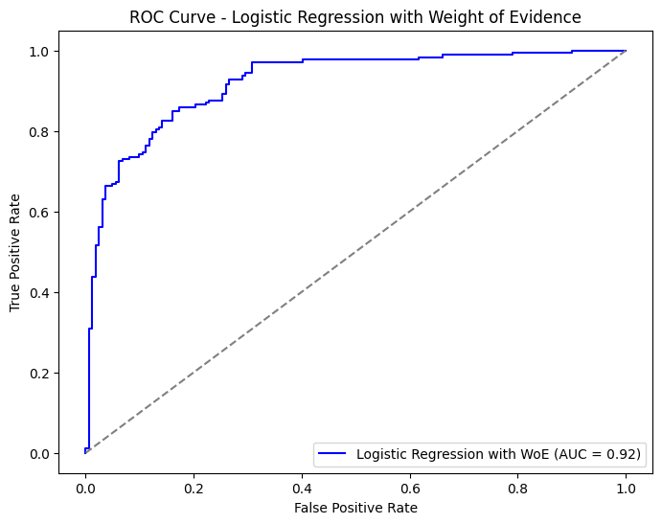
Logistic Regression with Weight of Evidence
The F1-score for this model is 0.82, showing a 1% improvement compared to the previous Logistic Regression model without Weight of Evidence (WoE). This difference could change further as more data is collected.

Slide 13
Logistic Regression Using Decision Tree Segments as Inputs
Segments from Decision Tree are used as inputs in Logistic Regression to boost the accuracy of the model.
A trial modelling has been done, which resulted in 89% Train Accuracy and 88% Test Accuracy, which is a huge difference compared to the regular Logistic Regression and Decision Tree models, which individually resulted in 81% and 83% Accuracy respectively.

Slide 14
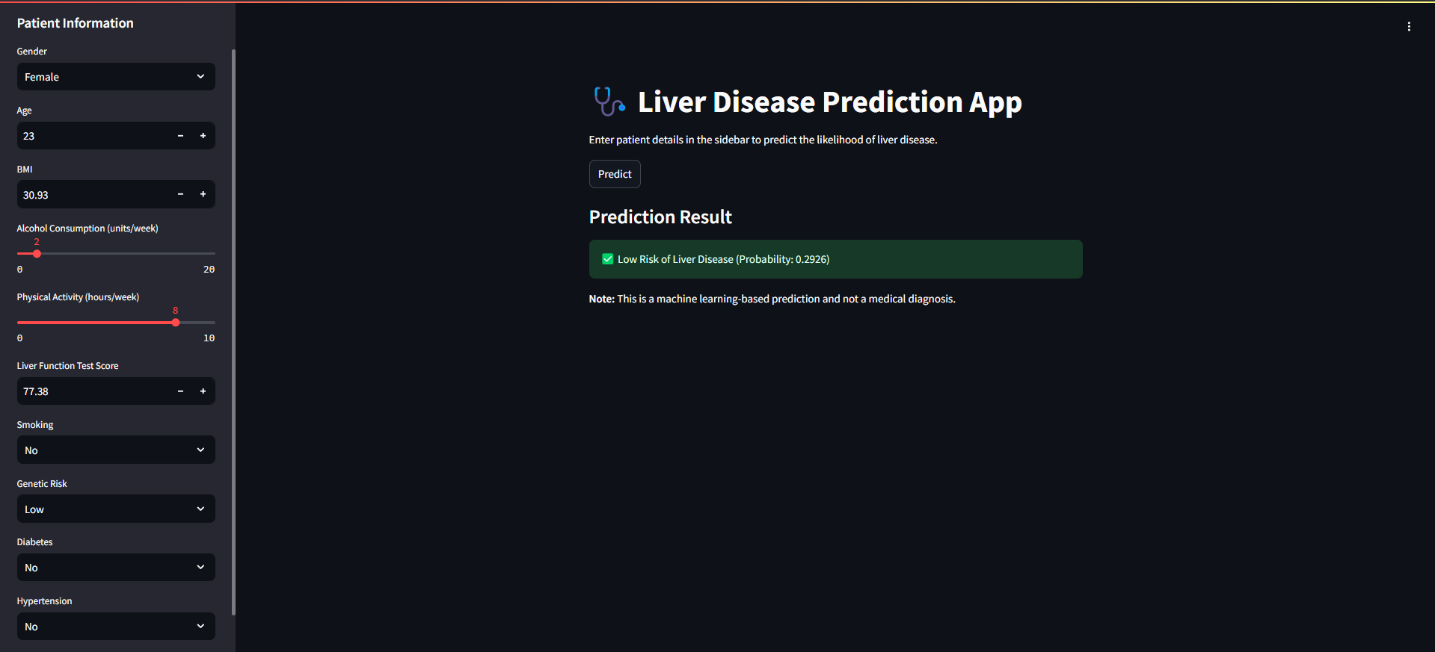
Model Deployment

